Slide 1


Comparing Australia to Indonesia
http://www.ifitweremyhome.com/compare/AU/ID

Slide 2
More facts
http://country-facts.findthedata.com/compare/87-170/Australia-vs-Indonesia

Slide 3
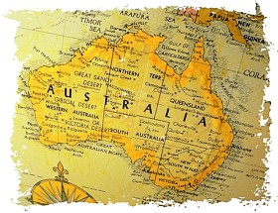
What type of government does Australia have?

Slide 4
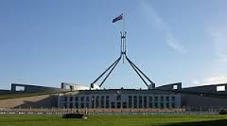
Democracy

Slide 5
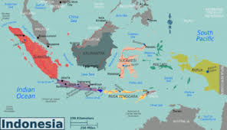
What type of government does Indonesia have?

Slide 6
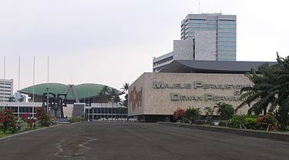
Republic

Slide 7
Now watch this about democracy in Australia.
https://www.youtube.com/watch?v=V7fIr-4BDNs

Slide 8
Information about the government in Indonesia.
http://www.indonesia-investments.com/culture/politics/general-political-outline/item385

Slide 9
Government in Indonesia
Indonesia is a constitutional republic. In 1945, it proclaimed its independence from the Netherlands. Indonesia’s federal system was abolished the following year, and the country became a Unitary Republic.

Slide 10
What is a Unitary Republic?
A unitary state is a state governed as a single power in which the central government is ultimately supreme and any administrative divisions (sub-national units) exercise only powers that the central government chooses to delegate. The majority of states in the world have a unitary system of government.

Slide 11
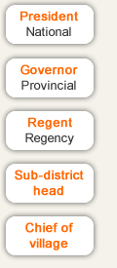
Three provisional constitutions define Indonesia’s governmental structure.
The first was proclaimed in 1945
The second was issued in February 1950
The third was passed 1950
In 1959 the constitution of 1945 was reinstated by presidential decree.

Slide 12
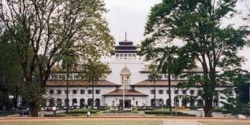
Indonesia has 3 divisions of government
The executive branch – led by the president, who is elected to a five year term by the legislative body, called the Peoples Consultative Assembly.
The People's Consultative Assembly – made up of 400 directly elected and 100 appointed members, plus an additional 500 legislators.
The Judiciary branch – which hears civil and criminal cases in district courts.

Slide 13

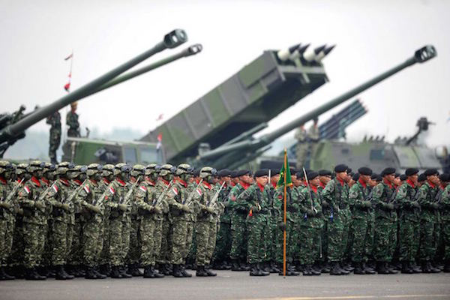
Indonesia has 3 major political parties
Indonesia’s armed forces come under the supreme command of the president.

